Slide 1






Integrated Climate-Resilient Transboundary Flood Risk Management in The Drin River Basin in The Western Balkans (Drin FRM project)
Overview of main outputs from Components 2 of the project
6 ( 5 extraordinary)^{TH} EWG on floods
12^{th,} December 2024

Slide 2
Key targets–Component 2
The Component 2 will straightening the existing transboundary cooperation in IWRM and develop policies for basin-wide climate responsive flood risk management, which also integrate environmental and socio-economic requirements including:
support the operation of the DCG Expert Working on Floods (Drin EWG Floods) during project implementation and will help identify and establish the long-term financing mechanism of the working group as part of the Drin Core Group operation.
review existing FM policy and enabling environments in each riparian country and develop basin FRM policies for the implementation of FRM legislative and policy framework in line with relevant EU directives.
Risk financing and transfer mechanisms products and tools will be identified (if existing) and/or developed based on detailed socio-economic risk, damages and losses assessment
Undertake detailed technical studies (including modelling) on climate change impacts on the identified sectors (energy and agriculture) in the DRB
Develop a DRB Stakeholders Analysis and the Governance Analysis focusing on Flood management
the effectiveness of institutional arrangements in individual riparian countries towards basin-scale flood risk management will be analyzed and if necessary, the ToR of the Drin EWG Floods will be revisited in terms of mandate, membership, resource requirements, technical capacity and technical enabling environment, data sharing and data access and technical means and tools for coordination
The Drin River basin FRM strategy (FRMS) and plan (FRMP) will be developed for the long-term management of flood risk in the basin

Slide 3
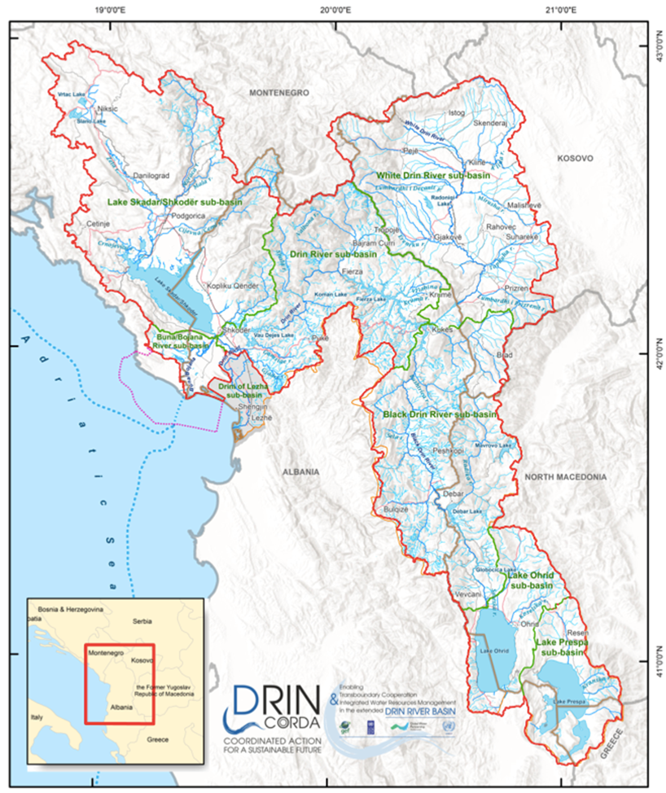
Key achievements –Component 2
Improved institutional arrangements, legislative and policy framework for climate-resilient FRM:
2.1 - DRB Policy Frameworks and improved long-term cooperation for FRM
Review of existing FRM policy, enabling environments and basin FRM policies
Basin-wide risk financing assessment (Strategy)
Risk financing and transfer mechanisms products development
Sector FRM policies, technical studies and recommendations (under development)
2.2 - Regional, national and sub-national institutions trained in flood risk management, roles and responsibilities clarified and coordination mechanisms strengthened for effective climate resilient FRM
Institutional mapping
Revision of the Drin EWG Floods ToR and development of a 5 yr. strategy and work program
2.3 – DRB FRM Strategy and Action Plan (under development)

Slide 4
Key achievements – Component 2
2.2 - Regional, national and sub-national institutions trained in flood risk management, roles and responsibilities clarified and coordination mechanisms strengthened for effective climate resilient FRM
Institutional mapping
Revision of the Drin EWG Floods ToR and development of a 5 yr. strategy and work program

Slide 5
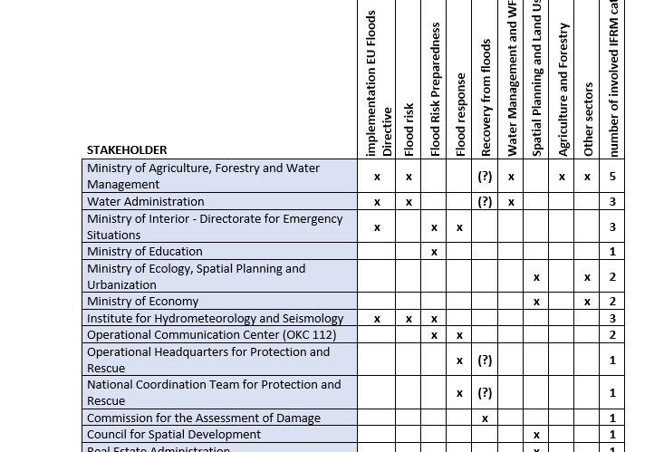
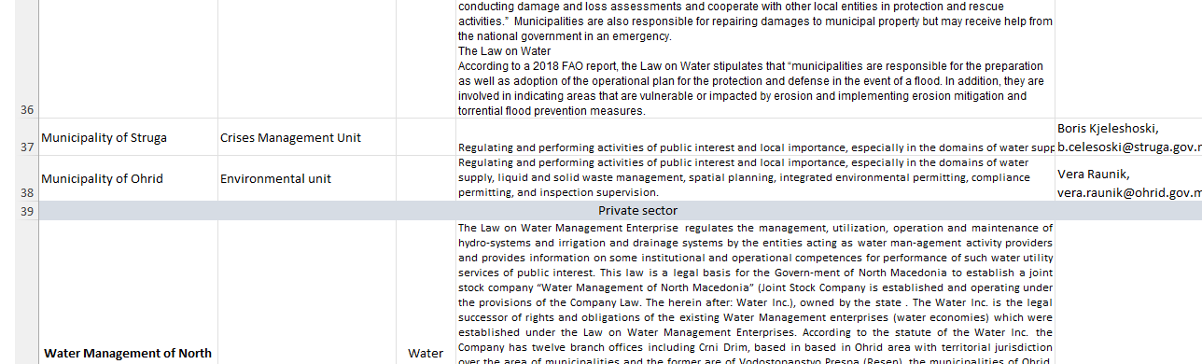
Key achievements – Component 2
Institutional mapping completed 2022
260 stakeholders screened

Slide 6
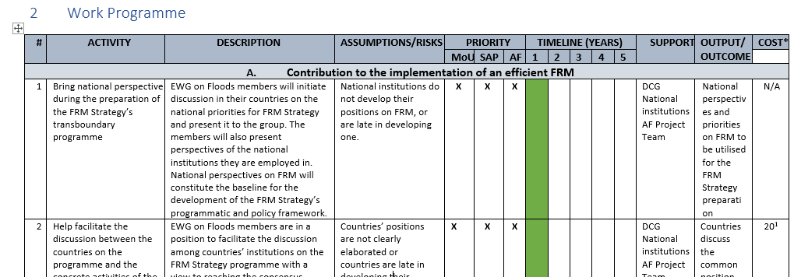
Key achievements – Component 2
Revision of the Drin EWG Floods ToR and development of a 5 yr. strategy and work program – completed December 2022
STRATEGY FOR THE DRIN/DRIM EXPERT WORKING GROUP ON FLOODS
FINAL WORK PROGRAMME FOR THE EWG ON FLOODS
TOR REVISED

Slide 7
Key achievements –Component 2
Improved institutional arrangements, legislative and policy framework for climate-resilient FRM:
2.1 - DRB Policy Frameworks and improved long-term cooperation for FRM
Review of existing FRM policy, enabling environments and basin FRM policies
Basin-wide risk financing assessment (Strategy)
Risk financing and transfer mechanisms products development
Sector FRM policies, technical studies and recommendations

Slide 8
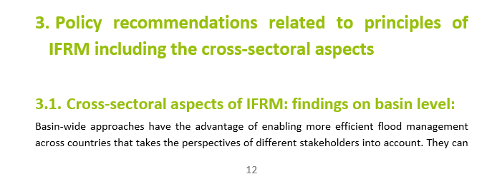
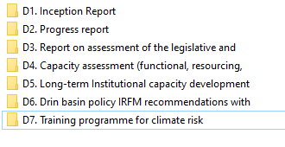
Key achievements –Component 2
Improved institutional arrangements, legislative and policy framework for climate-resilient FRM:
2.1 - DRB Policy Frameworks and improved long-term cooperation for FRM
Review of existing FRM policy, enabling environments and basin FRM policies –completed December 2022

Slide 9
Key achievements –Component 2
Improved institutional arrangements, legislative and policy framework for climate-resilient FRM:
2.1 - DRB Policy Frameworks and improved long-term cooperation for FRM
Review of existing FRM policy, enabling environments and basin FRM policies
Basin-wide risk financing assessment (Strategy)
Risk financing and transfer mechanisms products development
Sector FRM policies, technical studies and recommendations

Slide 10
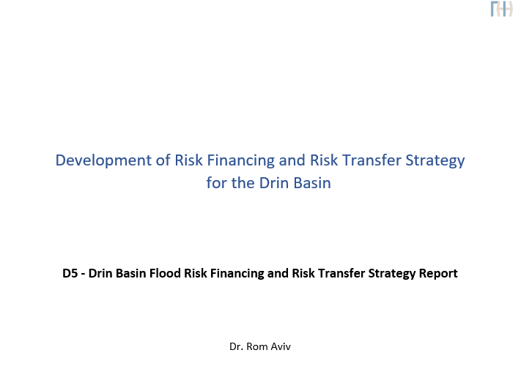
Key achievements –Component 2
Improved institutional arrangements, legislative and policy framework for climate-resilient FRM:
2.1 - DRB Policy Frameworks and improved long-term cooperation for FRM
Basin-wide risk financing assessment (Strategy)
Completed 2022

Slide 11
Key achievements –Component 2
Improved institutional arrangements, legislative and policy framework for climate-resilient FRM:
2.1 - DRB Policy Frameworks and improved long-term cooperation for FRM
Review of existing FRM policy, enabling environments and basin FRM policies
Basin-wide risk financing assessment (Strategy)
Risk financing and transfer mechanisms products development
Sector FRM policies, technical studies and recommendations

Slide 12
Key achievements –Component 2
Improved institutional arrangements, legislative and policy framework for climate-resilient FRM:
2.1 - DRB Policy Frameworks and improved long-term cooperation for FRM
Risk financing and transfer mechanisms products development – to be completed 2024

Slide 13
Key achievements –Component 2
Improved institutional arrangements, legislative and policy framework for climate-resilient FRM:
2.1 - DRB Policy Frameworks and improved long-term cooperation for FRM
Review of existing FRM policy, enabling environments and basin FRM policies
Basin-wide risk financing assessment (Strategy)
Risk financing and transfer mechanisms products development
Sector FRM policies, technical studies and recommendations

Slide 14
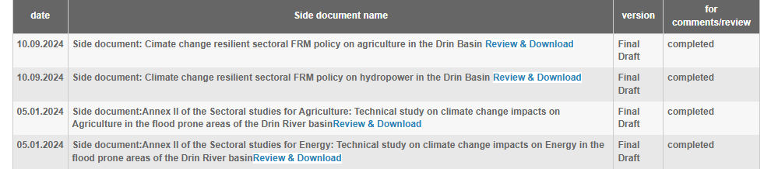
Key achievements –Component 2
Improved institutional arrangements, legislative and policy framework for climate-resilient FRM:
2.1 - DRB Policy Frameworks and improved long-term cooperation for FRM
Sector FRM policies, technical studies and recommendations completed 2024

Slide 15
Key achievements –Component 2
Improved institutional arrangements, legislative and policy framework for climate-resilient FRM:
2.1 - DRB Policy Frameworks and improved long-term cooperation for FRM
Review of existing FRM policy, enabling environments and basin FRM policies
Basin-wide risk financing assessment (Strategy)
Risk financing and transfer mechanisms products development
Sector FRM policies, technical studies and recommendations (under development)
2.2 - Regional, national and sub-national institutions trained in flood risk management, roles and responsibilities clarified and coordination mechanisms strengthened for effective climate resilient FRM
Institutional mapping
Revision of the Drin EWG Floods ToR and development of a 5 yr. strategy and work program
2.3 – DRB FRM Strategy and Action Plan

Slide 16
Key achievements –Component 2
Improved institutional arrangements, legislative and policy framework for climate-resilient FRM:
2.3 – DRB FRM Strategy and Action Plan – integration of all deliverables from component 2 and more
Institutional and legal setup, capacity assessment for the FRM in the Drin
Stakeholder analyses
EWG on floods strategy and WP
FRMP and FRMS
Sectoral study and policy on Agriculture in the Drin RB
Flood risk transfer Strategy
Sectoral study and policy on Energy in the Drin RB
Feasibility study for flood risk transfer mechanisms

Slide 17
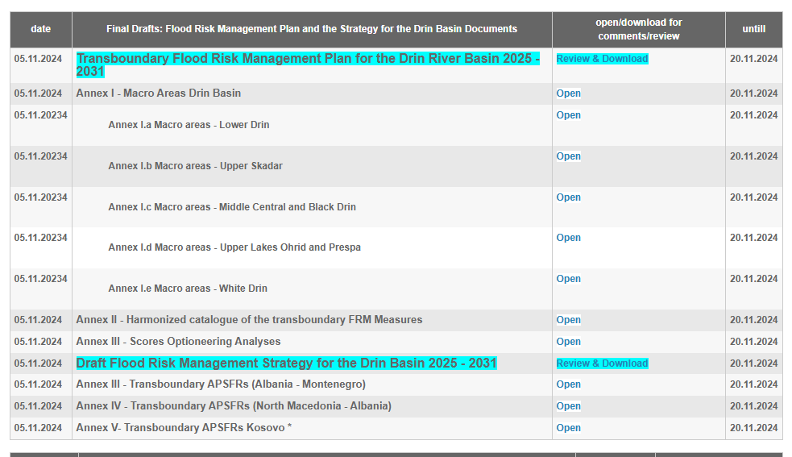
Key achievements –Component 2
Improved institutional arrangements, legislative and policy framework for climate-resilient FRM:
2.3 – DRB FRM Strategy and Action Plan – completed December 2024

Slide 18
Integrated Climate-Resilient Transboundary Flood Risk Management in The Drin River Basin in The Western Balkans (Drin FRM project) –
Component 2
THANK YOU FOR ALL JOINT WORK!

